Slide 1
IoT Based Intelligent Dustbin Monitoring System
Jannatul Ferdaus (17201117)
Hosain Mohammd Shafa khan (17201020)
Md. Habibullah Sheikh (17201049)
Department of Computer Science and Engineering
University Of Asia Pacific
Supervised By
Shammi Akhtar
Assistant Professor,
Department of CSE, UAP

Slide 2

What is Intelligent Dustbin Monitoring System?
Intelligent Dustbin Monitoring system is a very innovative system which will help to keep the cities clean.

Slide 3
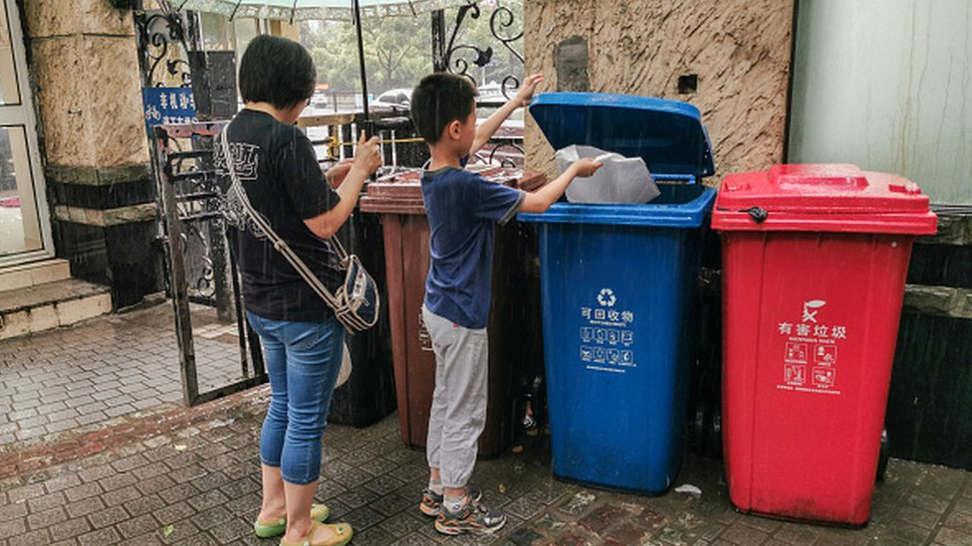
Motivation
In cities avoid unhygienic & ugliness condition we come up a project called Intelligent Dustbin. Which is a GSM based waste and garbage collection bins overflow indicator systems for smart cities.

Slide 4

Importance
→ Keeps the surroundings clean and green, free from bad smell of wastes
→ Reduces manpower requirements to handle the garbage collection process

Slide 5
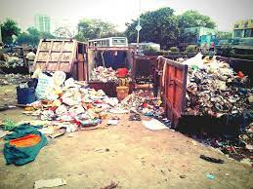
Social issues related to the project
.
Solves the social issue of waste disposal.
Reduces the spread of deadly diseases.
Environment friendly and sustainable too.

Slide 6
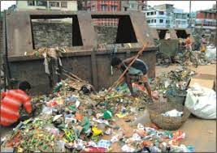
Health & Safety issues related to the project
Priority to reduce environmental pollution and to ensure the safety of public health.
Protects against the virus, bacterial attack.

Slide 7
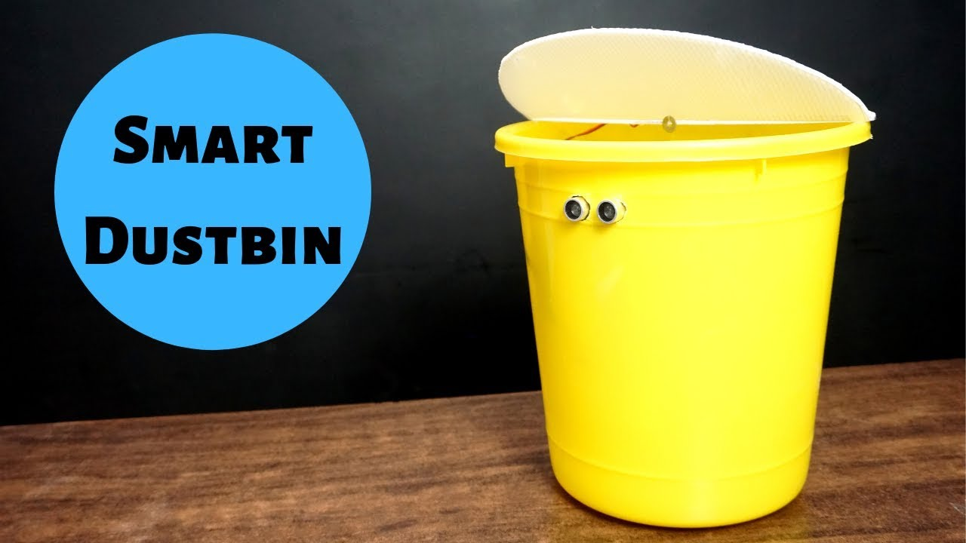
Related Existing System
Smart Dustbin by using ultrasonic sensor
Services:
→It will automatically open the lid. →Can be used easily.
→ User friendly system

Slide 8
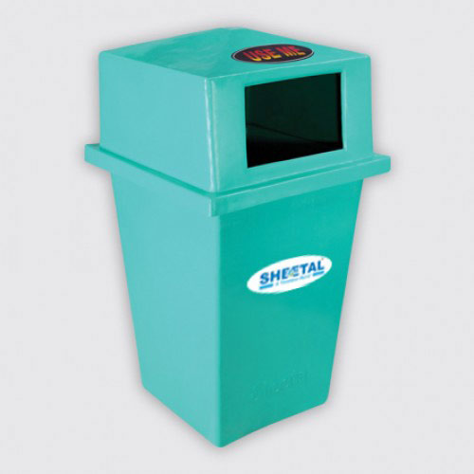
Related Existing System
Waste Container
Services:
→Providing greater accessibility planning proper for disposing of process.
→Reduce Environmental Pollution.

Slide 9

Limitations with existing System
→Don't send a message in case of garbage overflown. →No led indicates whether the dustbin is full or not, So people can’t understand the dustbin is full or empty.

Slide 10
Proposed System
→The proposed system will help to avoid the overflow of dustbin. →We will able to know the real-time information about the level of the dustbin. →When the dustbin becomes full it will send the message to the Garbage collector immediately.

Slide 11
Development tools
Hardware:
1.Ultrasonic sensor 7. PCB Board 2.GSM 900 8. Jumper wires 3.Arduino UNO 9. Header Pins 4.Servo Motor 10.Dustbin 5.PIR Sensor 11. LED 6. DC Jack Software: Arduino IDE Language: C / C++

Slide 12
Planning for next Semester
Task
Managing components
Project Setup
Coding
Testing
Error Fixing & Final Implementation
Final Report Writing
Time Duration
Week 1 & 2
Week 3 & 4
Week 5 & 6 & 7
Week 8
Week 9 & 10
Week 11 & 12 & 13 & 14

